Slide 1


ARTIFICIAL INTELLIGENCE PSYCHOTHERAPIST

Slide 2


INCLUDED IN OUR TEAM ARE:
AFIYA
AGAMYA
NEHA
NAMITHA
MAYITRI

Slide 3
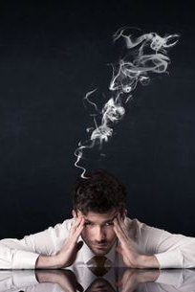
EMPATHY:
WHY DO PEOPLE SEEK PSYCHOTHERAPY?
You’re experiencing feelings of extreme sadness and helplessness
You’ve Run Out of Advice from Friends and Family
3.You’re Using Alcohol, Drugs or Other Unhealthy coping mechanism.
4. You or a Loved One Are Living with a Chronic Health condition.
5. You’re Undergoing a Big Change.
6. You’ve Recently Lost a Loved One or Close Friend
7. You Feel Like You’ve Lost Control
8. You’re Having Family Issues
9.You Suspect You Have a Serious Mental Health Condition

Slide 4

Defining the problem:
Why are people hesitant towards taking therapy?
1.JUDGEMENT:
“I think that in this day and age, our society is so focused on bigger, better, faster, stronger, that unfortunately, something like seeking help for mental health issues can be perceived as being weak,”
2. DOUBT:
Another obstacle that prevents people from seeking mental health care is their doubt that it will work, often based on bad experiences they’ve heard about. “Unfortunately, some people have had negative experiences with the mental health care system
3. Pride
Sometimes pride poses an interesting challenge as well, in that people have a hard time admitting they need help and surrendering to the treatment process. “Sometimes people think that they should be able to solve their problems without any input from a professional,”

Slide 5
4. Fear
Another primary reason people avoid therapy is the fear they harbor: “Fear of change, fear of the unknown, fear that they may outgrow their friends, family and loved ones,”
5.Not giving it enough time.
Finally, some people might give therapy a try but then stop before they can make any real progress. “Many people will meet with a therapist once or twice and then stop altogether, for a myriad of reasons,”

Slide 6

Ideate:
How do we solve the problem?
After conducting light research to clearly understand what cutting-edge technologies can offer and how we could use them to create a product or service with market potential, we focused on ideation to find a solution that would improve the lives of our users with artificial intelligence (AI)
One of the main benefits of using AI based psychotherapy is its ability to analyze and collect data.
The high cost of traditional therapy is one of the major reasons as to why people are hesitant towards taking therapy but that can be fixed by providing AI based therapy.
Empathetic chatbots could also be useful for peer support.

Slide 7
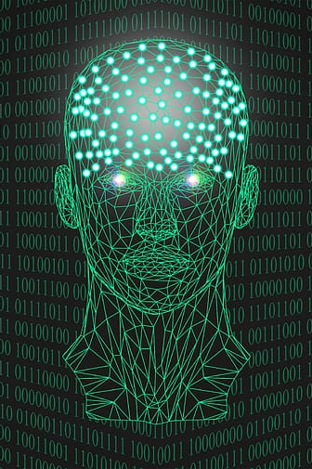
Prototype:
THE FEATURES OF AI BASED PSYCHOTHERAPIST INCLUDE:
1.Therapeutic personal assistant:
Provides therapy and emotional support to the individuals
2.Notifications:
For older adults with Alzheimer’s it can be a reminder and converse with them .
3.Sharing:
Can create real time chatbots which can understand human emotions and feelings and respond accordingly. Especially giving

Slide 8
3.By being supportive:
By sharing their feelings and progress with others users get more support and understanding.
4.Natural Language Processing:
Communication data archives from the patient feed dynamically adapting to each patient and mental health situation
5. Availability:
By being ever present the ai assistant can be consulted anytime answering questions and providing feedback. Daily mood tracking and data visualization charts
6. Anonymous and non- judgmental:
users can discuss their concerns without the fear of being misjudged
7. Immediate responses:
Helps to address urgent or time sensitive concerns
8.Multilingual support

Slide 9
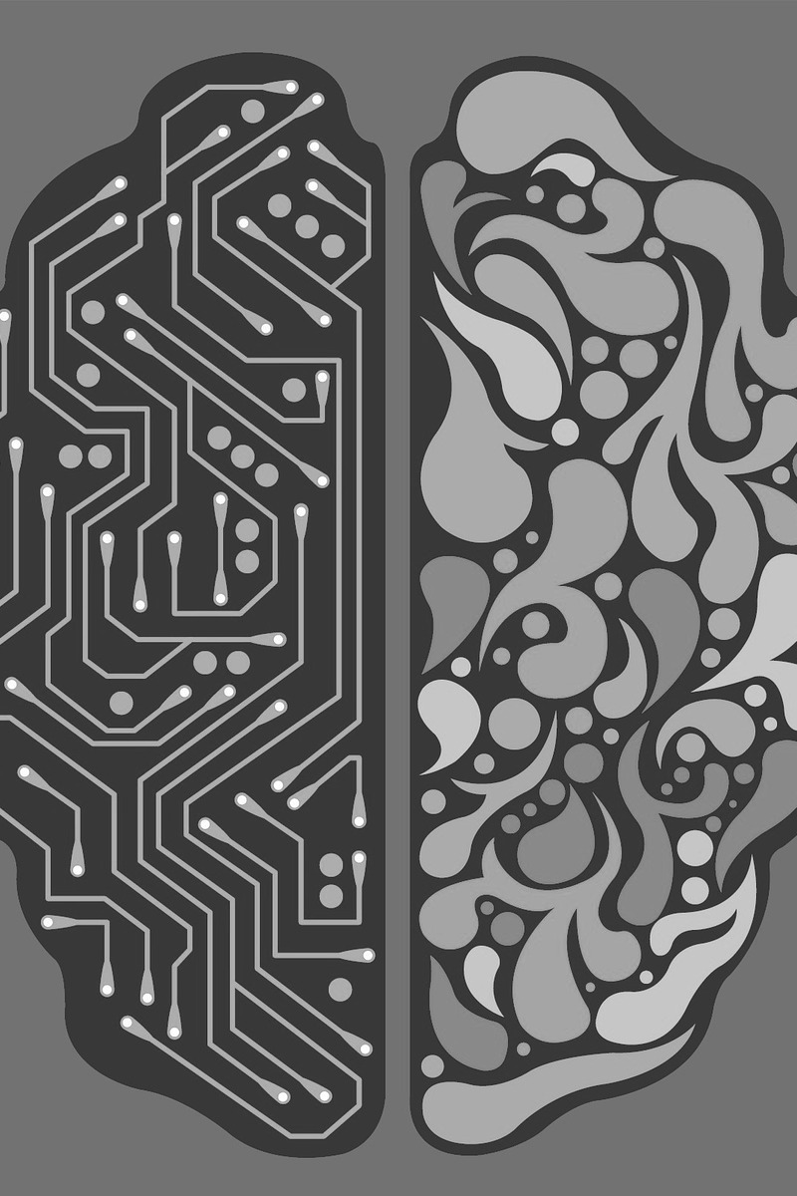
Conclusion:
AI continues to open exciting possibilities across various domains especially the healthcare domain. However, it is essential to remember that AI based therapists offer valuable features and accessibility, they should complement, not replace, human therapist, especially for individuals with complex or severe development or severe mental health issues.

